Slide 1
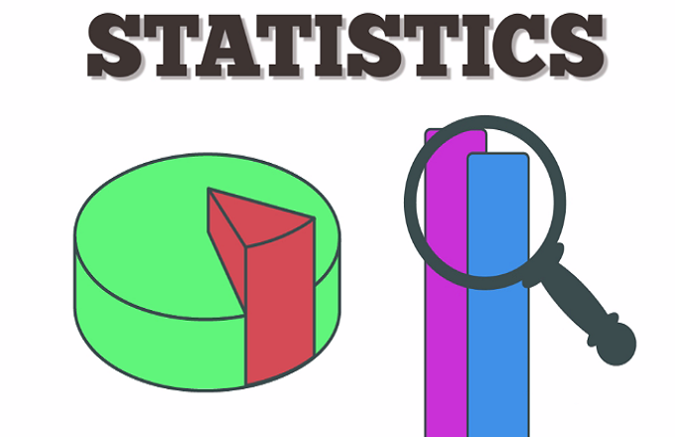
Introduction to Statistics and Analytics
Notes:
https://www.utdallas.edu/~scniu/OPRE-6301/documents/What_Is_Statistics.pdf

Slide 2
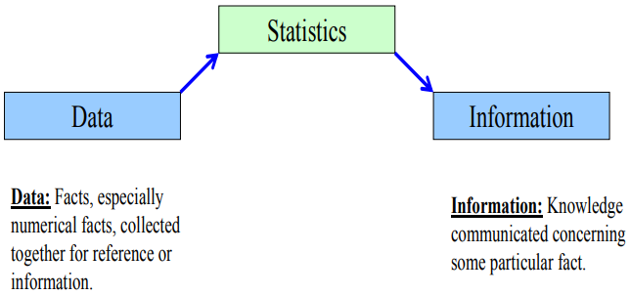
What is Statistics?
“Statistics is a way to get information from data.”
Statistics is a tool for creating an understanding from a set of numbers.

Slide 3
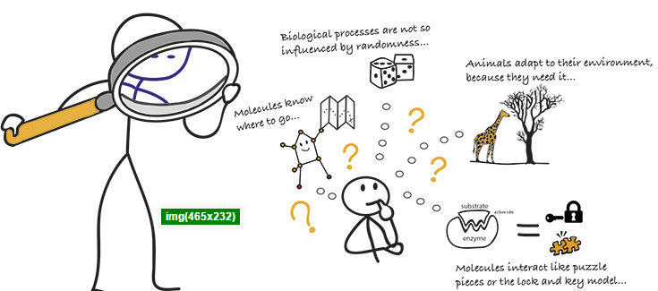
Key Statistical Concepts
Population
The population is all the individuals in a group.
frequently very large; sometimes infinite.
Sample
The sample is some of the individuals in a group.
Potentially very large, but less than the population.
Parameter
Defines a characteristic of the population.
Statistic
Defines a characteristic of the sample.

Slide 4
Key Statistical Concepts
Independent Variable.
The variable that experimenters choose to manipulate; it is usually plotted along the x-axis of a graph.
Dependent Variable.
The dependent variable of a study is the variable that experimenters choose to measure during an experiment; it is usually plotted along the y-axis of a graph.

Slide 5
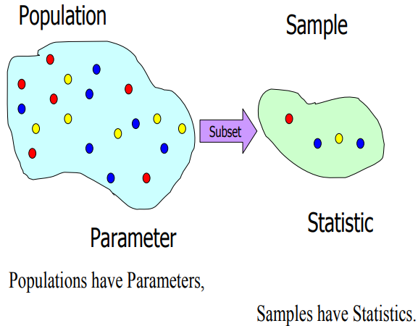
Population vs Sample

Slide 6
Descriptive Statistics
Are methods of organizing, summarizing, and presenting data in a convenient and informative way.
Graphical Techniques
Numerical Techniques
The actual method used depends on what information we would like to extract.
measure(s) of central location? and/or
Mean/ Median/ Mode
measure(s) of variability (dispersion)?
Range/ IQR/ Variance/ Standard Deviation

Slide 7
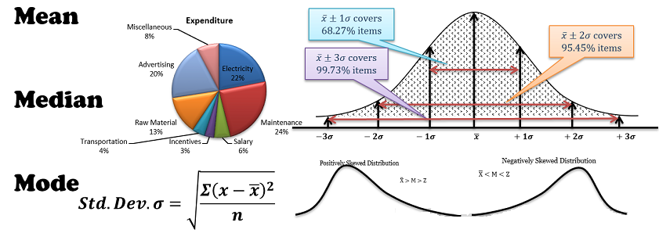
Descriptive Statistics

Slide 8
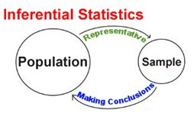
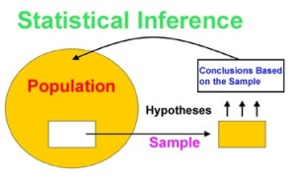
Inferential Statistics
Descriptive Statistics describe the data set that’s being analyzed.
But doesn’t allow us to draw any conclusions about the data.
Hence we need another branch of statistics: inferential statistics.
Inferential statistics is also a set of methods,
But it is used to draw conclusions or inferences about
characteristics of populations based on data from a sample.

Slide 9
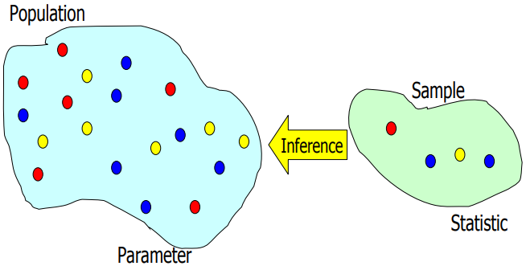
Statistical Inference. . .
Statistical inference is the process of making an
estimate,
prediction, or
decision
about a population based
on a sample.
We use statistics to make
inferences about parameters.

Slide 10


